Slide 1
Programming for Data Science Introduction to Python
Dr. Ahmad Altarawneh
Department of Data Science
Faculty of information technology, Mutah university

Slide 2
Outline
History of python
Python applications and use
Python for data science
Python pros and cones
Python installation
Python shell

Slide 3
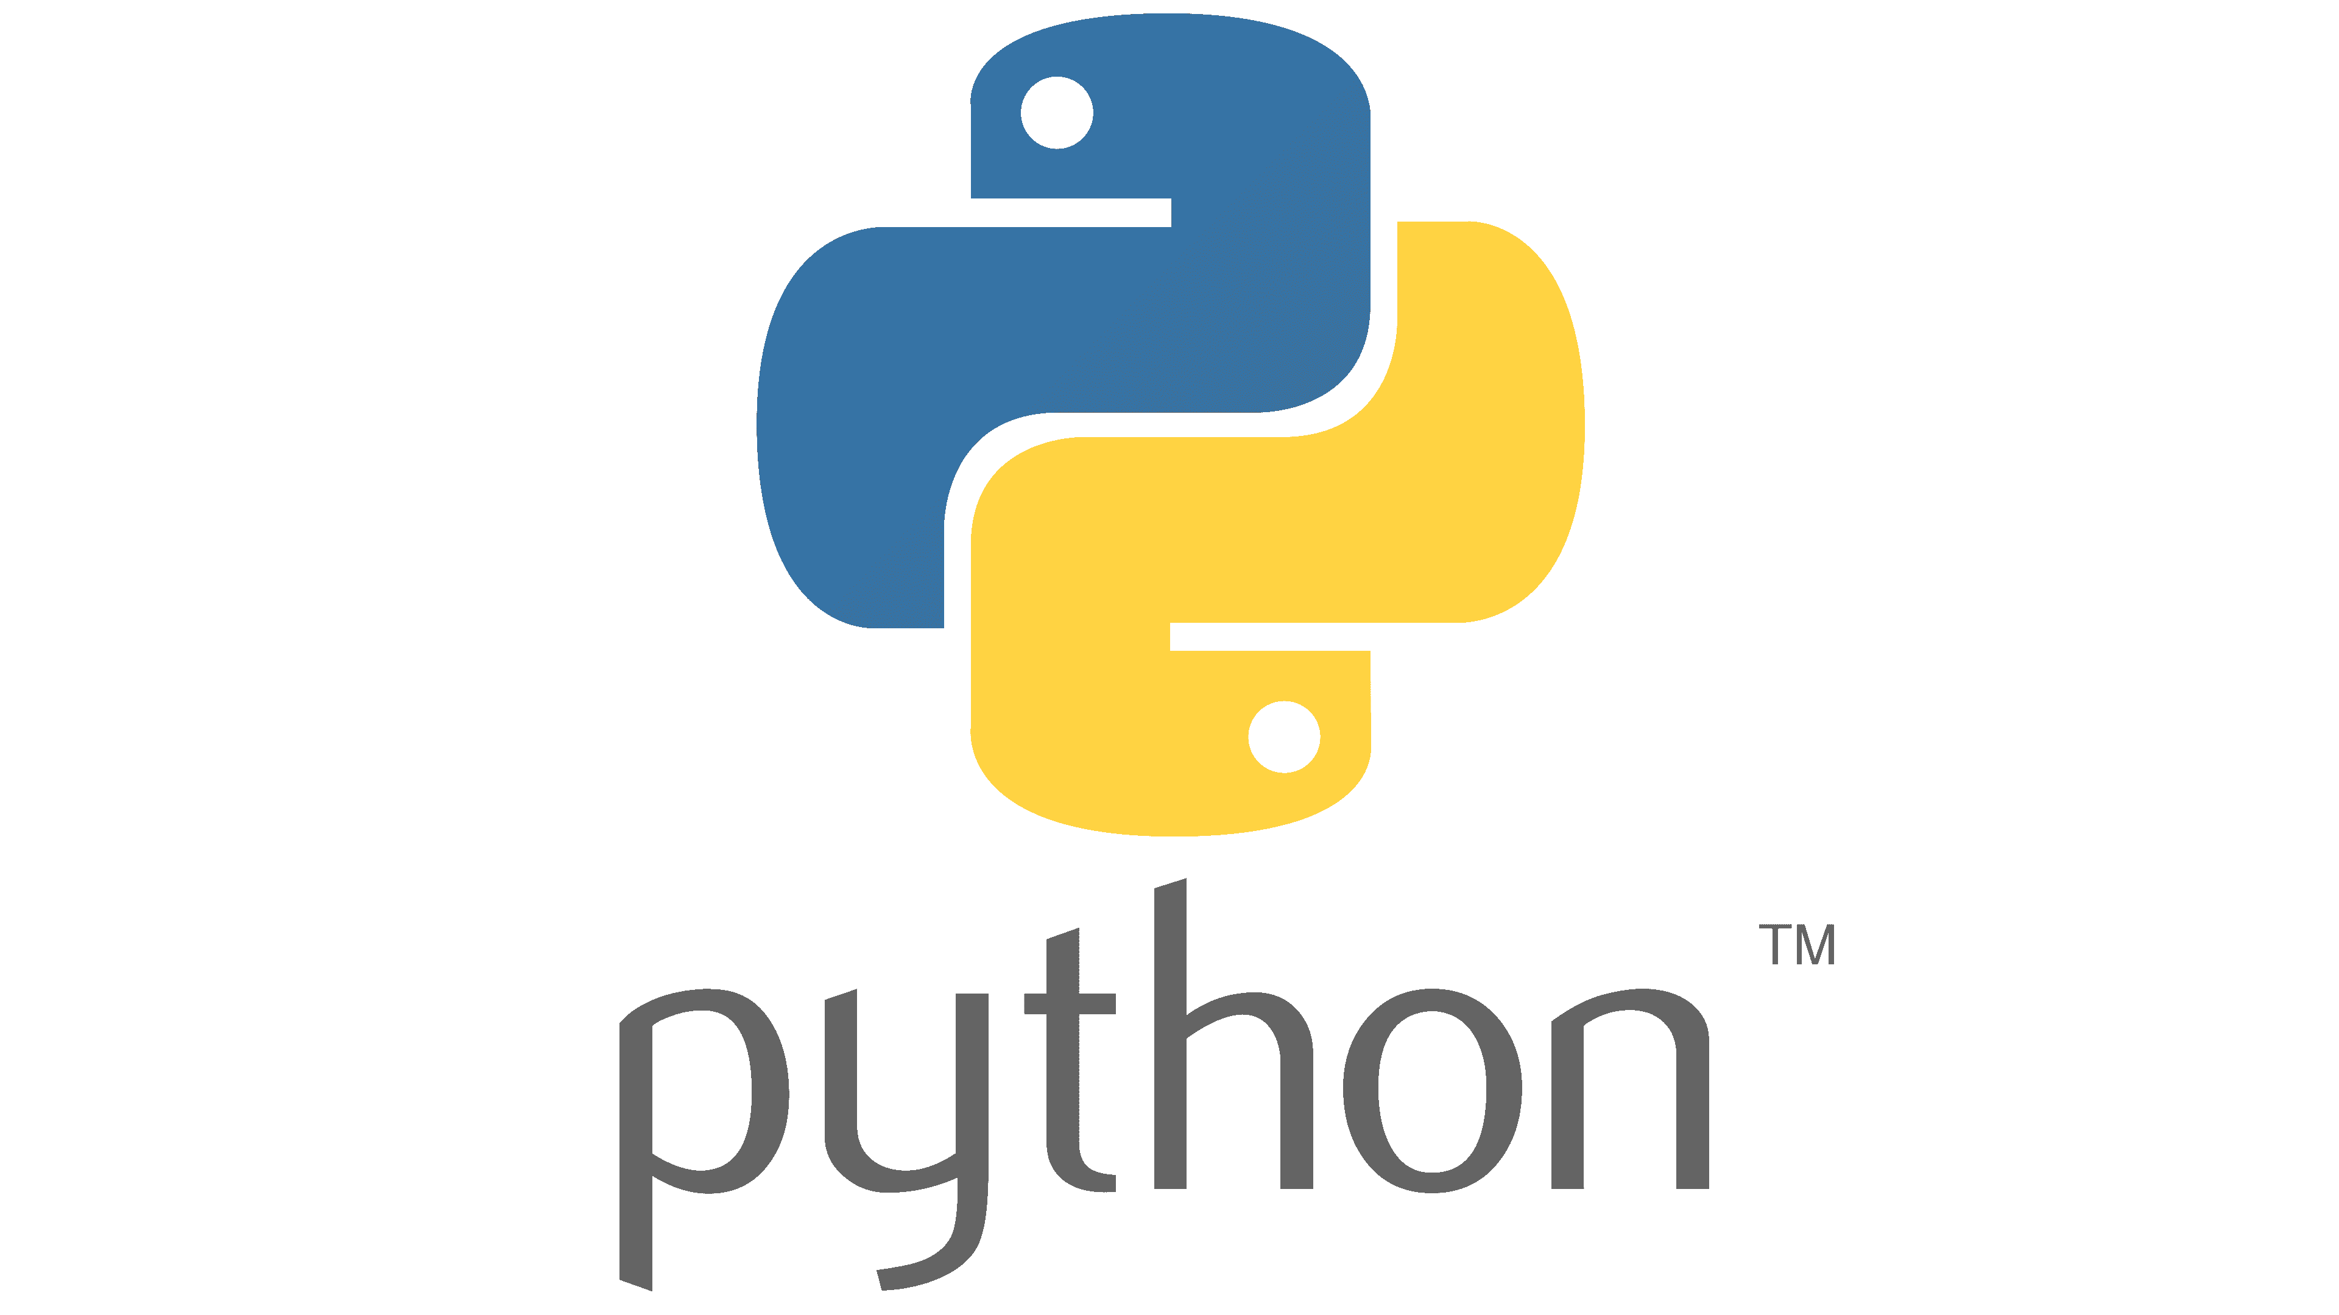
Python
Python is a free, open-source programming language developed by Guido van in 1991.
Python is a programming language with strong abstraction from the details of the computer (High-level programming language)
Python is a general-purpose programming language
for building software in a wide variety of application domains
Python is a multi-paradigm programming language.
it supports different styles of writing code. One can write Python code in procedural, object oriented, functional, etc.

Slide 4
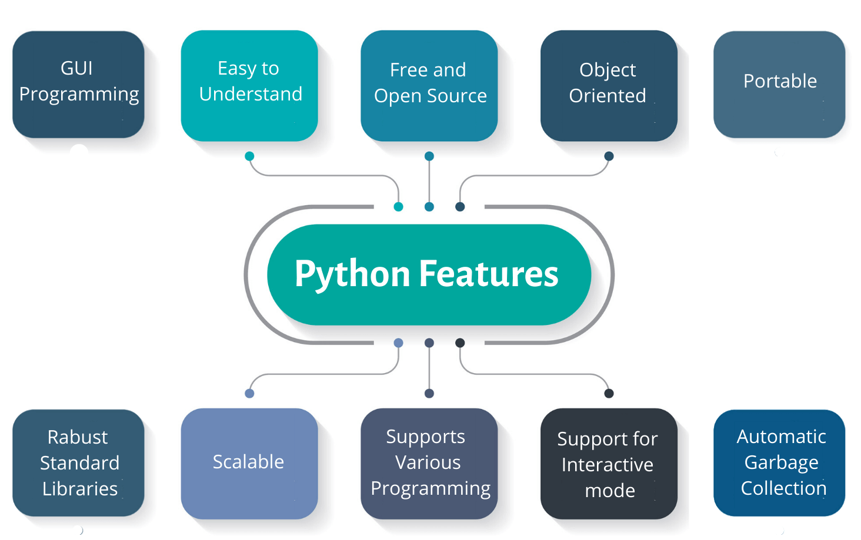
Python features

Slide 5
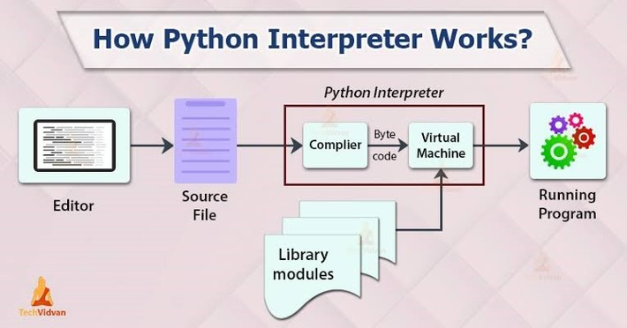
Portable
Python code can be executed on different platforms i.e., operating systems without significant modifications
This is done with the help of the interpreter
Python is interpreted language: executed by an interpreter, a program that reads and executes the source code line-by-line
Python has a compilation step, which involves converting Python code to bytecode to be executed on the PVM (the interpreter)
This makes Python a cross-platform language (write once, run anywhere)

Slide 6
Garbage collection
It is a technique used my python for memory management
Its main goal is to destroy objects that have 0 references.
Python uses an algorithm called reference counting to keep track of the objects in memory
when the reference count becomes 0, the object is removed (collected) from the memory
More on reference counting will come when we study variables, later on

Slide 7
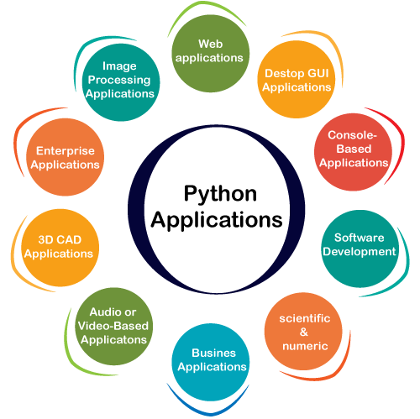
Python applications
Python is used for wide range of applications
Signal processing
Image processing
Machine learning
Data analysis
Game development
3D modeling
Animation and visualization
Big data analysis
many more

Slide 8
Python for data science
Python is a powerful tool which massively used in data science applications
There are many libraries that support working on data analysis tasks
Pandas: Library used for data analysis and manipulation
Sklearn: Contains a large set of ML and data pre-processing algorithms
Tensorflow: Library used for Deep learning and neural network algorithms
Scipy: Library used for signal processing
Open-CV: Library used for image processing and computer vision applications
Nlptk: Used for natural language processing applications
……

Slide 9
Pros and cons
Pros: Python has many advantages, including but not limited to:
Readability: The code is easy to read, follow and interpret
Easy to learn: Python syntax is very simple and intuitive
General purpose: Can be used for any application you could think of
Expressive: Can do tasks in fewer line of codes, compared to other languages like C/C++
Cons
As an interpreted language, Python is generally slower than compiled languages like C or C++.
Memory usage: Python has heavy memory usage, due to the immutability property of the objects
Mobile Development: The features needed for mobile application development are not mature yet

Slide 10
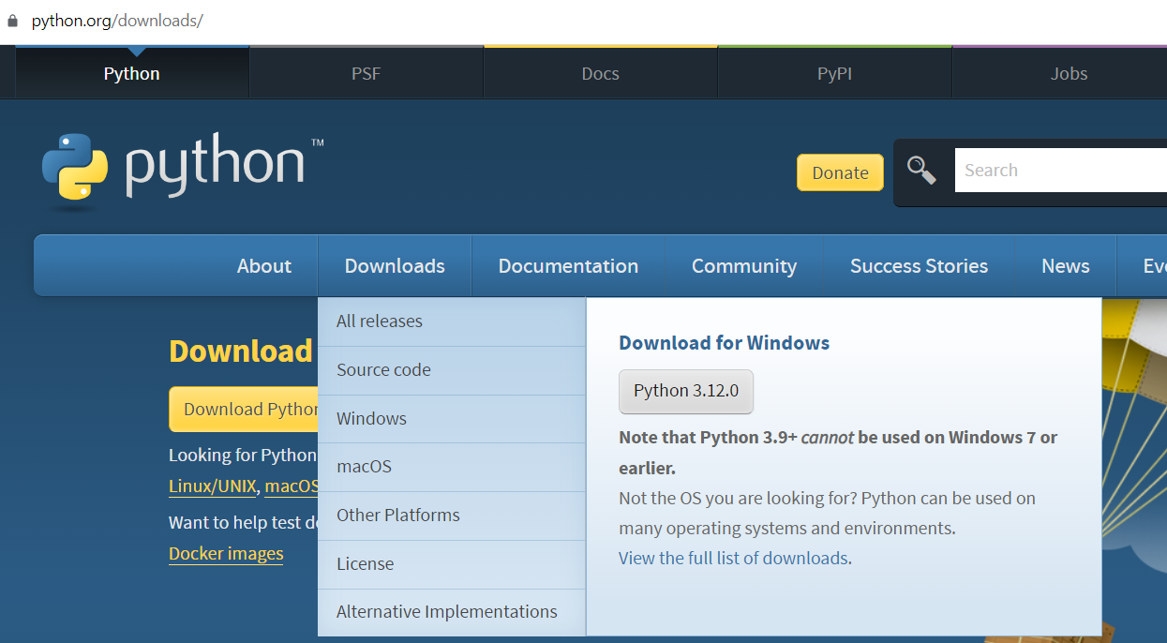
Python installation
Visit the Python official website: https://www.python.org/downloads/
However, the download button
Press the button shown in the following figure
You can choose the release you want, from all releases

Slide 11
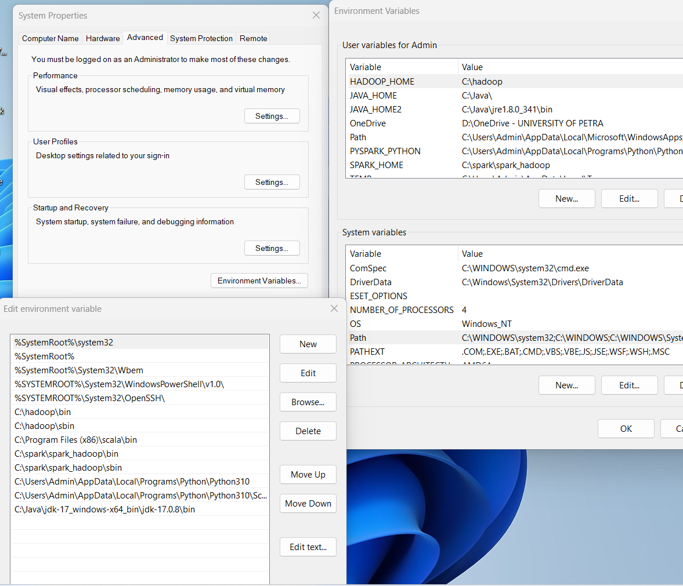
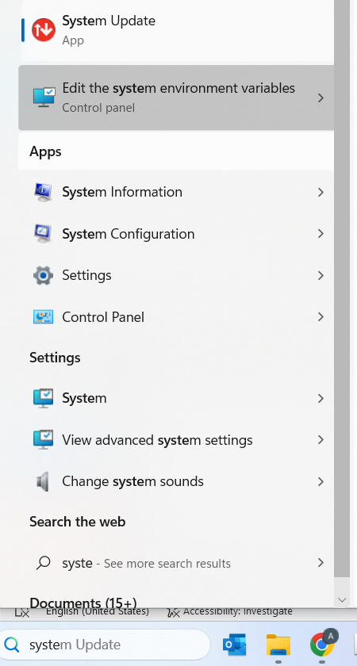
Add to system variables
1
2
3
4

Slide 12
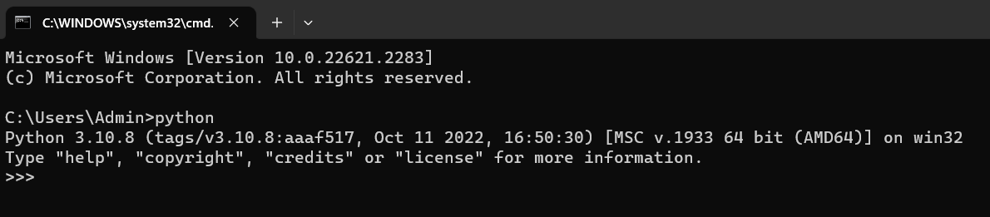
Check the installation
Press Ctrl + R
Type cmd to run the command prompt
type python and press Enter

Slide 13
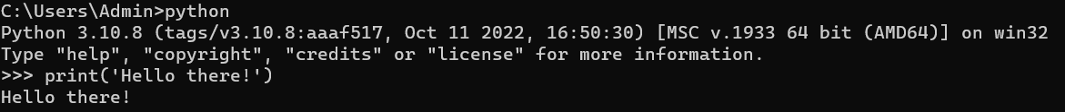
Python shell (interactive mode)
C:\Users\Admin>python
Python 3.10.8 (tags/v3.10.8:aaaf517, Oct 11 2022, 16:50:30) [MSC v.1933 64 bit (AMD64)] on win32
Type "help", "copyright", "credits" or "license" for more information.
>>> Write python code here
You can use this shell to run python code

Slide 14
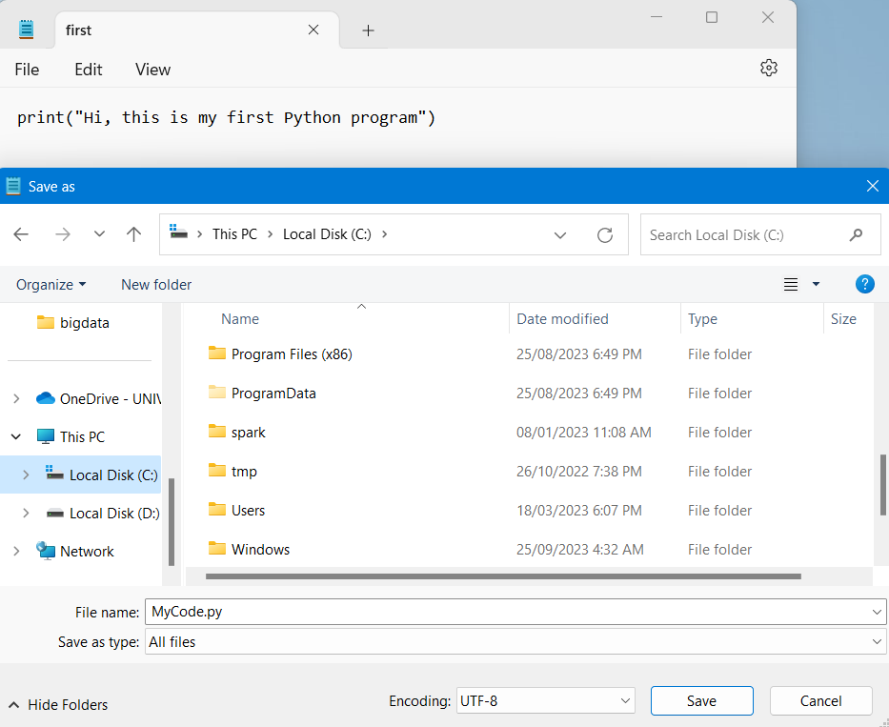
Script mode
You can use the command prompt to execute python scripts
Open a text file and write your python code
save this file as .py
Open command prompt
type python your/file/path.py

Slide 15
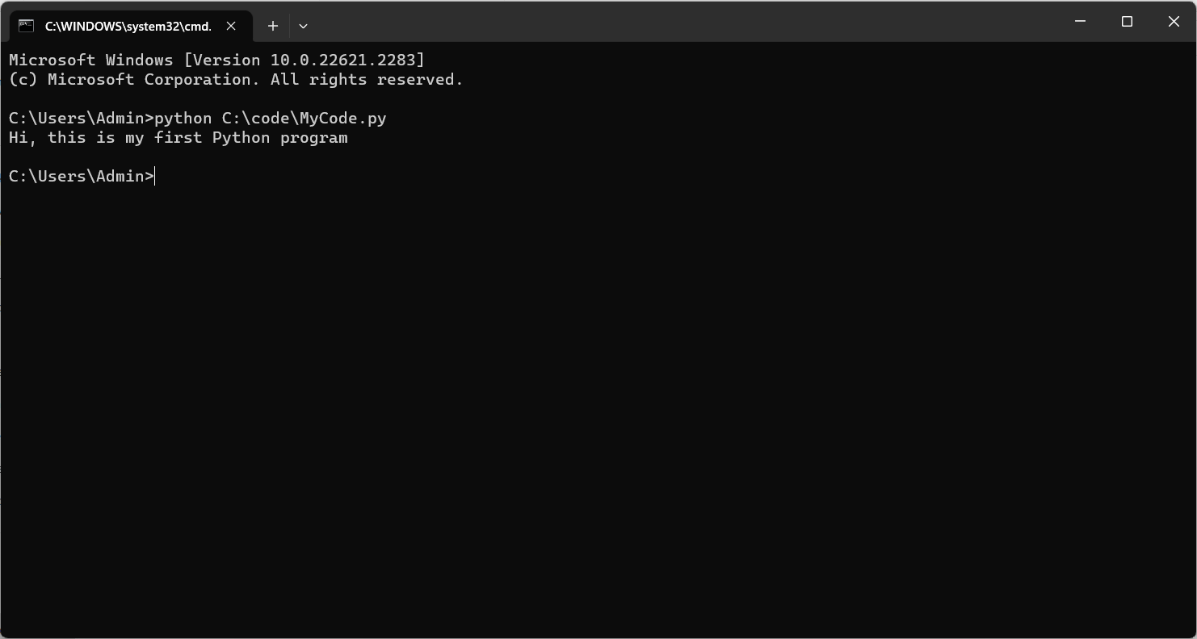

Slide 16
Anaconda
Always it is better to use an integrated development environment IDE
IDE provides a convenient way to write your code
Better organization of your code
Easier for debugging
Easier for variable tracking
There are many IDE's you can use for python programming
Spyder, Pycharm and VSCode
Anaconda is a good environment for python programming
Ancaonda contains Spyder as an IDE and you can implement python interactively using Jupyter notebook
Anaconda gives you better way to manage your packages and virtual environments

Slide 17
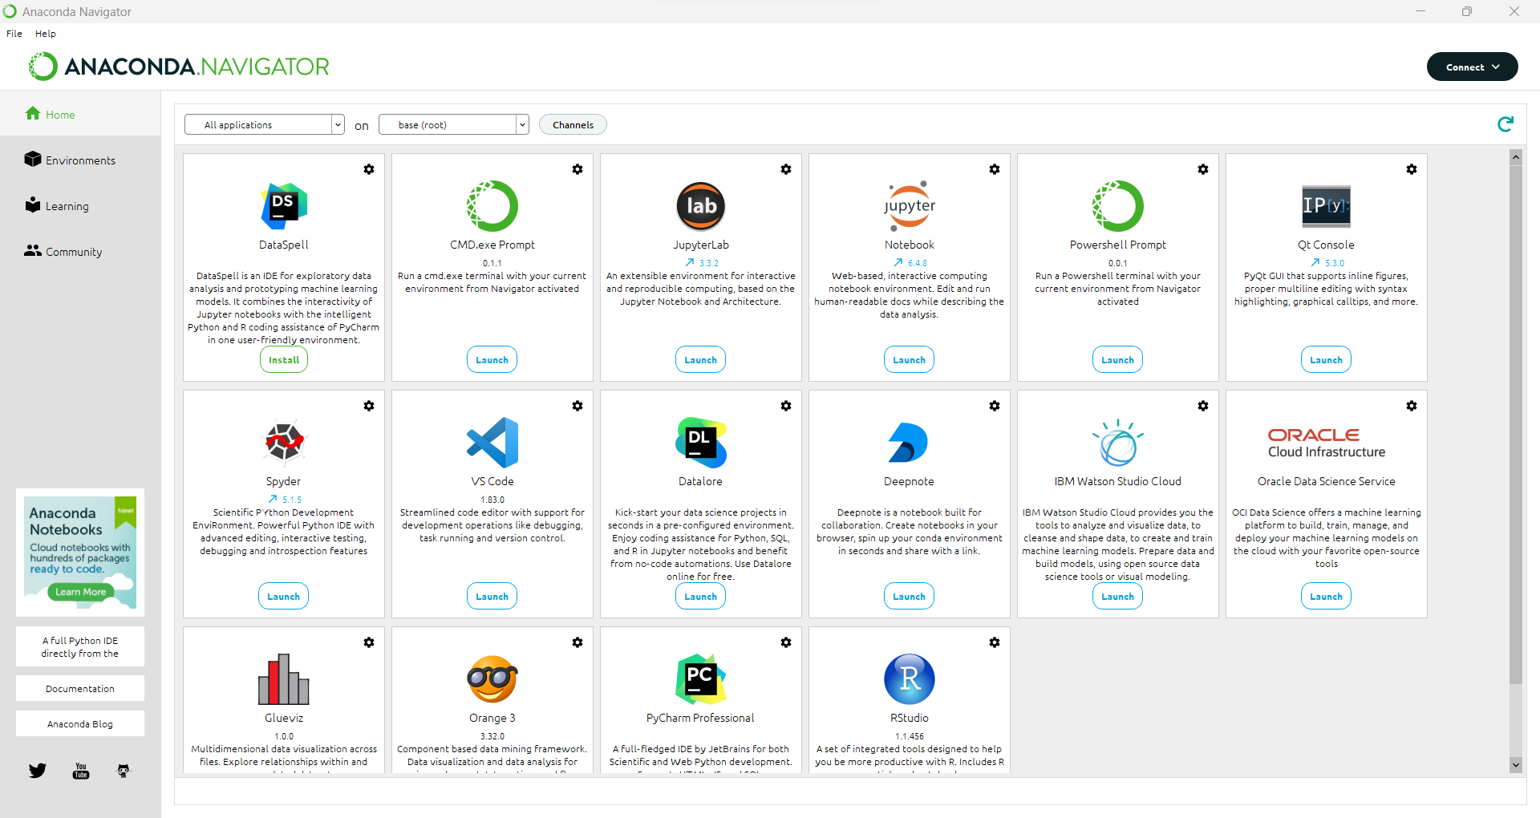

Slide 18
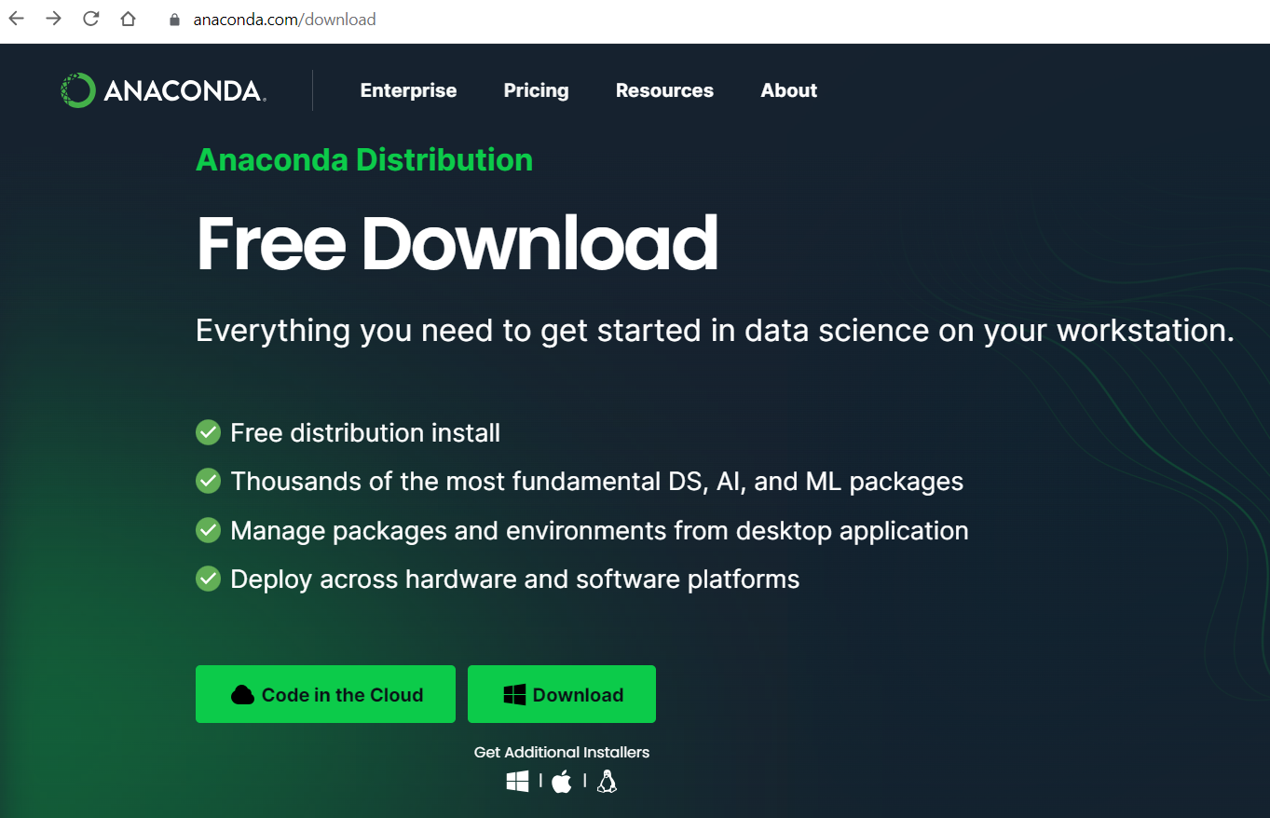
Installation of Anaconda
Visit the Anaconda website and download it: https://www.anaconda.com/download
Run the installer and proceed with the installation

Slide 19
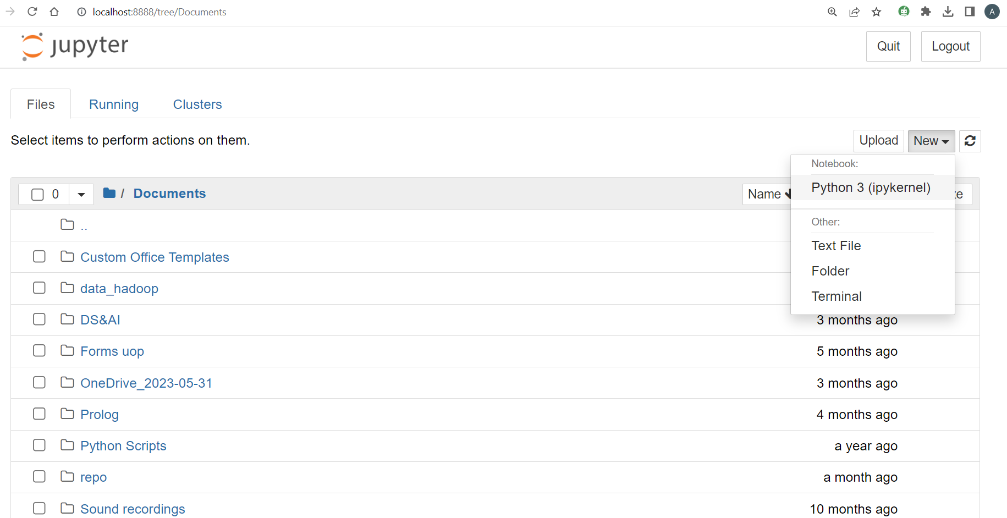

Slide 20
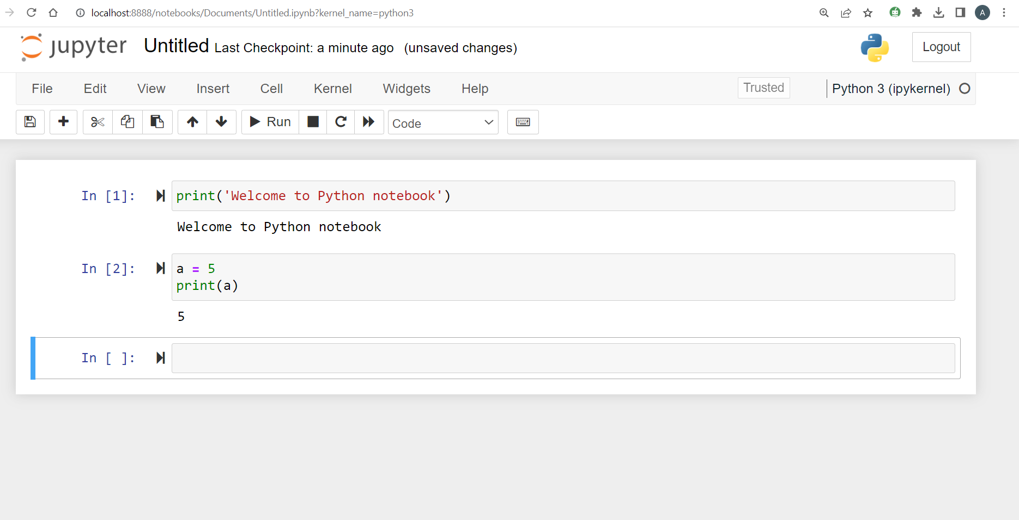

Slide 21
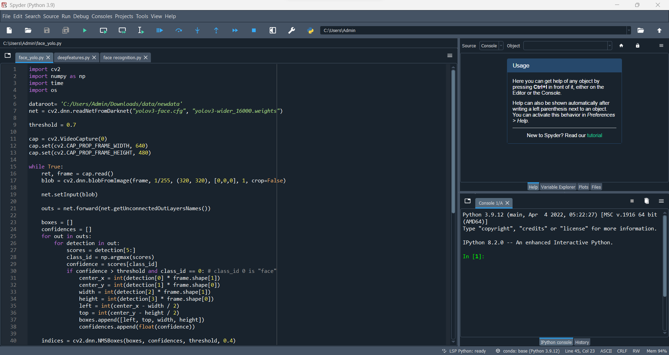
Spyder

